Slide 1
READ ME FIRST
This is a template slide deck to use when presenting Virtual Wallet to INDIVIDUALS.
There are separate template slide decks to use when presenting to your colleagues and PAs/Providers. Go to: myvirtualwallet.co.uk > Support Hub > Professionals > Comms Hub.
You can amend it to personalise it your local area – for example:
Amend the What it means locally slide and include your logo.
If you don’t offer Supported Accounts, delete the references to Supported Accounts.
This template gets updated periodically to incorporate feedback and new developments, so check the Comms Hub regularly, which also includes more images and content that you can download and use in slide decks and elsewhere.

Slide 2
Introduction for Individuals
December 2024

Slide 3
Contents
What is Virtual Wallet
What it means locally
How it works
Benefits
What it looks like
Where to get more info
Summary

Slide 4
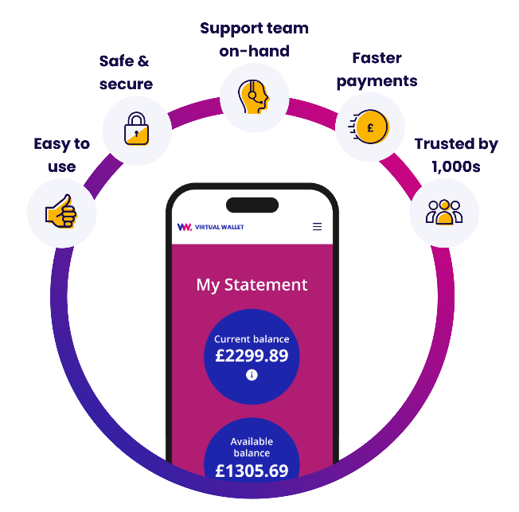
What is Virtual Wallet?
Managing your own care and support
via a direct payment is one of the best kept secrets in health and social care, as it gives you choice & control.
Virtual Wallet doesn’t change any of that – it just makes it easier for you by putting the management of your direct payment in one place – your hands.
Virtual Wallet is a safe and easy way to manage your direct payment in one place, using your phone or a computer.
Your direct payment gets paid straight in to your Virtual Wallet. Once the care or support received is confirmed, Virtual Wallet pays your carers and providers.

Slide 5
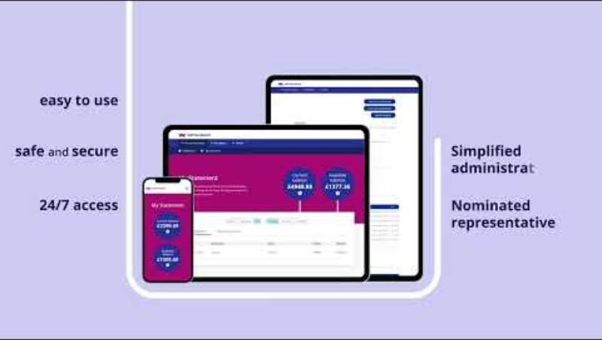
3 minutes of your time?

Slide 6
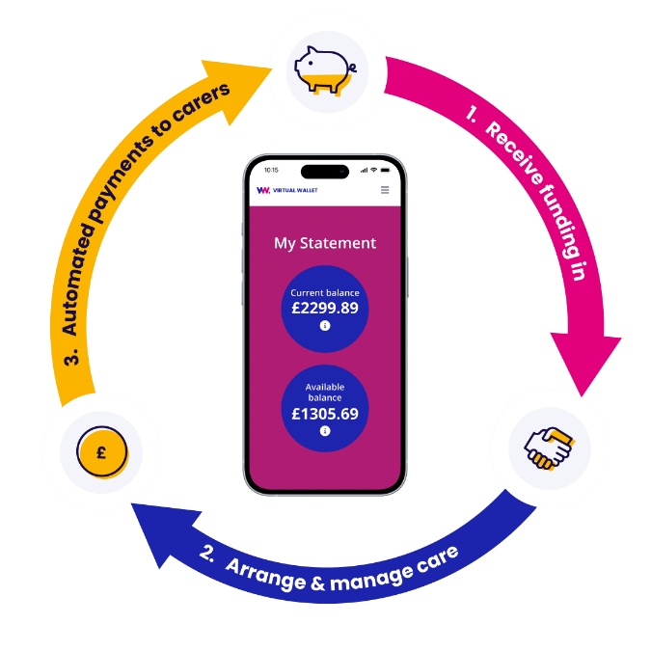
What it means locally
Virtual Wallet [is new for us, has been operating here since mm/yy].
Virtual Wallet is our preferred way of managing direct payments as it makes it easier for you, your providers and us.
Over time, it will replace [pre-paid cards, separate bank accounts, managed accounts].
Over time, Virtual Wallet payroll will replace [existing payroll provider].
The Direct Payments Support Service provided by XYZ will still continue.
The Virtual Wallet support team will be on-hand to help people through the change.

Slide 7










How it works
>>Money in>>
>>Money out>>
Arrange and manage care & support
Your local council
Payments to care providers
NHS
Wages to PAs
Client contribution
Tax to HMRC
Client top-up
Pensions contributions
Other sources
Unused funds returned to source
Too view all our icons see our asset library
View asset library

Slide 8


How to access
There are three ways your account can be managed
SELF-SERVICE
Virtual Wallet is designed to be used by the individual receiving the care, using their phone or a computer. We call this a self-service account. It can sound daunting, but there are thousands of people using it up and down the UK.
FAMILY & FRIENDS
Self-service isn’t the right choice for everyone. You can ask family or friends to help. We call this being an ‘authorised representative’
SUPPORTED ACCOUNT
You may be able to opt for a Supported Account where the team at PPL operate your Virtual Wallet account for you. These are sometimes also called a ‘managed account’.
You can watch one-minute videos that explain each of these at myvirtualwallet.co.uk
When you are ready to get going, you will get an email from the Virtual Wallet team asking you to activate your account

Slide 9


Supported Account?
WHAT IS IT?
You are still in charge of how your direct payment is spent, but the team at PPL manage your Virtual Wallet account for you.
HOW DOES IT WORK?
You agree with PPL how they will find out about how your direct payment is being spent. You can still log in to keep an eye on the money coming in and out.
CAN I HAVE ONE?
It is for people who can’t manage their Virtual Wallet account themselves and who don’t have a suitable friend or family member to help.

Slide 10

How payroll works
When you have a Virtual Wallet account, there are two options for managing payroll if you employ a PA
1. Virtual Wallet Payroll
2. Third-party Payroll
Fully integrated
Timesheet processing and payroll calculations are all done by Virtual Wallet
Everything is in one place
Less risk of delays
Low cost
All queries to the Virtual Wallet team
They receive timesheets and do the calculations
They send the information to the Virtual Wallet team for payments to be made from your Virtual Wallet account
Payroll queries to your payroll provider, payment queries to the Virtual Wallet team
Useful if you have a good relationship with your existing payroll provider

Slide 11
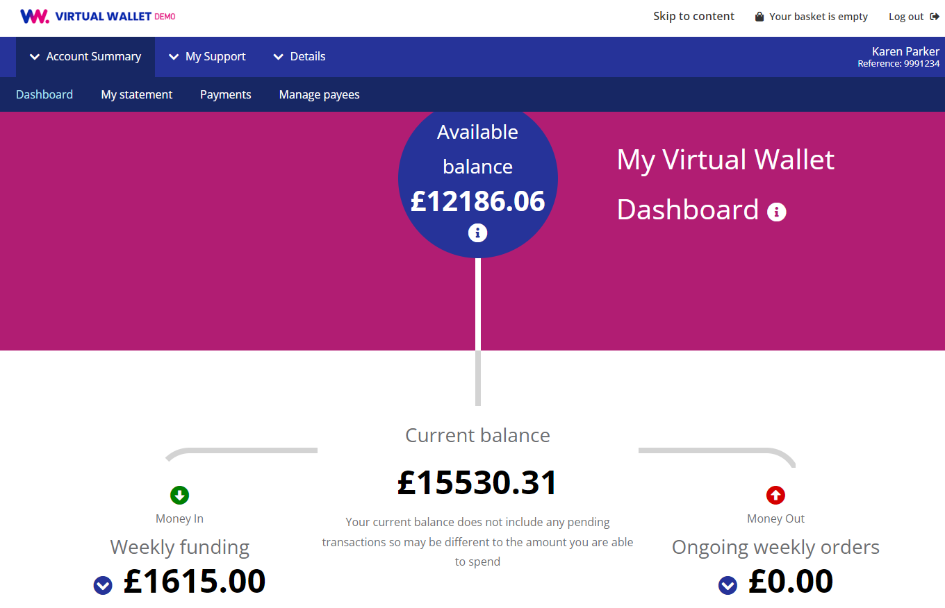
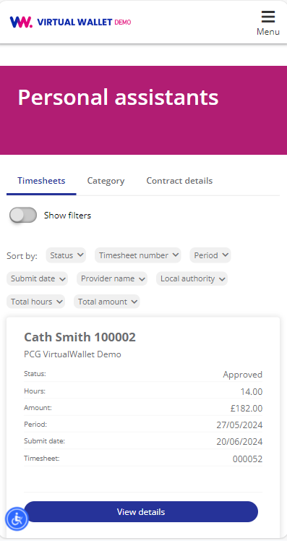
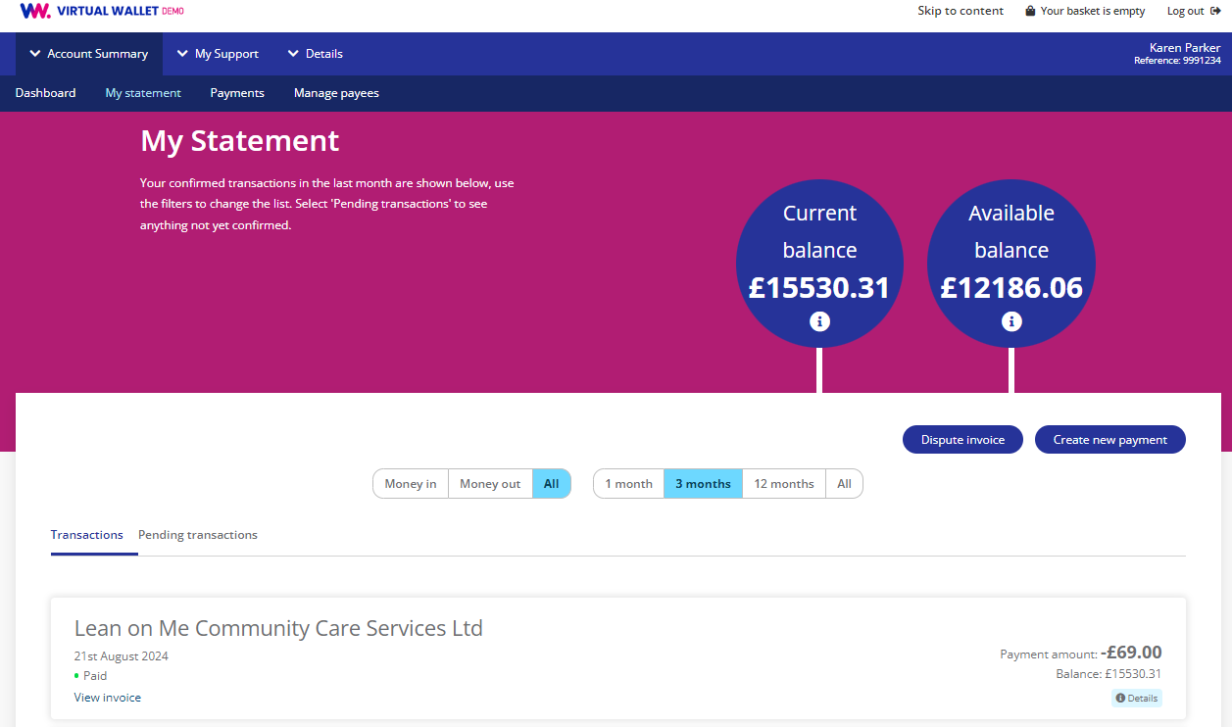
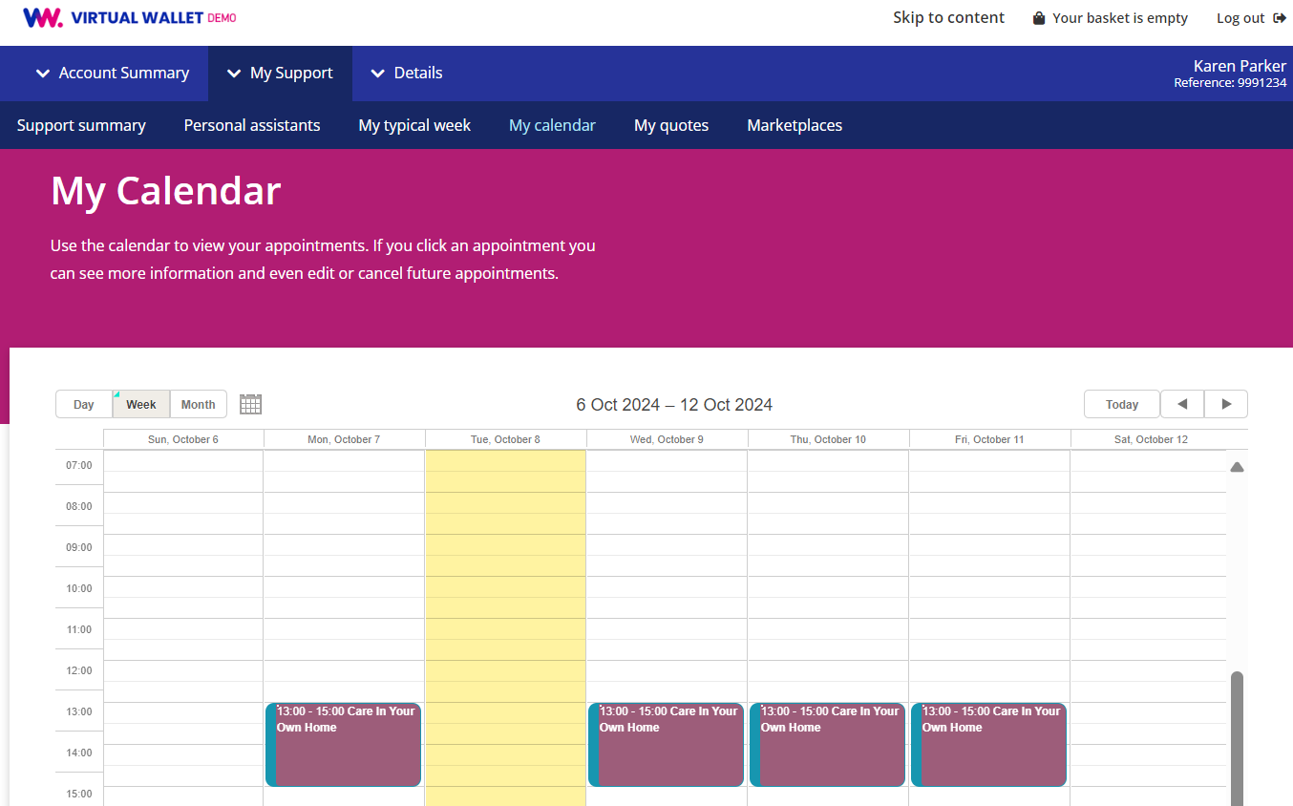
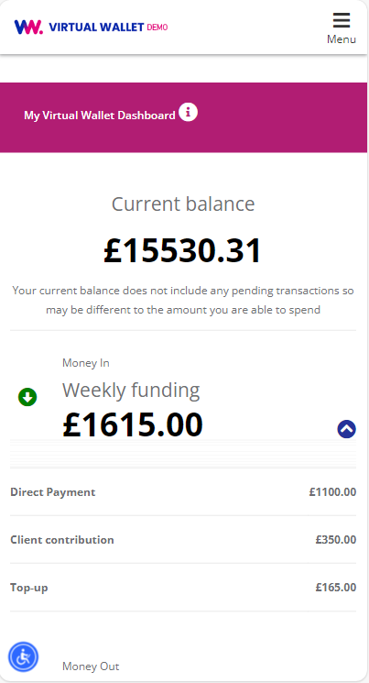
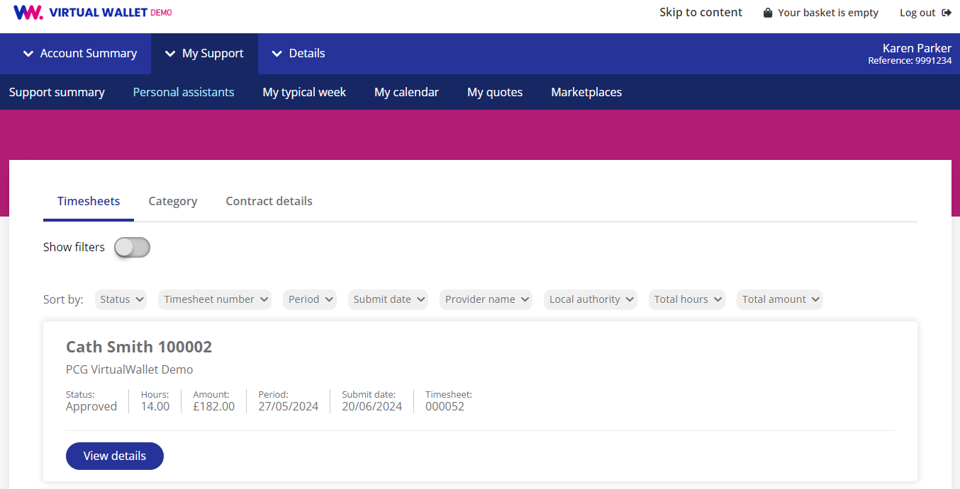
What does it look like?

Slide 12
The benefits for YOU
Easy, secure, 24/7
Less admin & hassle
VW Support Team are on-hand to help
via web-chat, email or phone

Slide 13
What do people say?
“I find it very easy to use….the simplicity of it is the best thing…I see an invoice from the PA, I click on a couple of buttons and approve it, and she gets paid.”
Clive and Marilyn
“My son uses it to manage my husband’s direct payment remotely. It’s fairly automatic…you can see what funds you’ve got…it's all there”.
Jacqueline and Les
“I don’t have to do anything at all. Having now used Virtual Wallet for a year, I would recommend Virtual Wallet to others…and have”.
Lucy and Katie

Slide 14
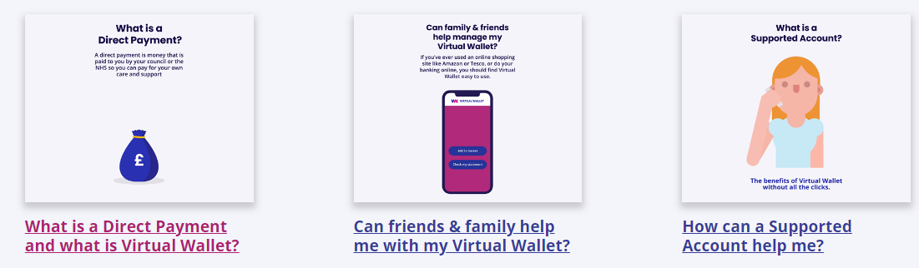
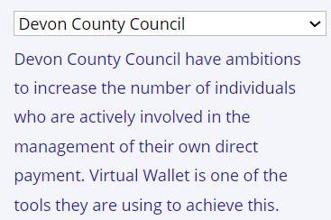
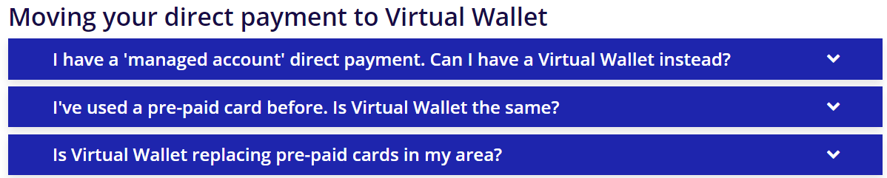

Where to get more information
Go to myvirtualwallet.co.uk
One-minute-long explainer videos:
Local info:
Frequently asked questions:
And, once you get started:
How to guides, videos, FAQs, contacts

