Slide 1
READ ME FIRST
This is a template slide deck to use when presenting Virtual Wallet to COLLEAGUES within your LA/ICBs.
There are separate template slide decks to use when presenting to individuals and PAs/Providers. Go to: myvirtualwallet.co.uk > Support Hub > Professionals > Comms Hub.
You can amend it to personalise it your local area & audience – for example:
Amend the What it means locally slide and include your logo.
If you don’t offer Supported Accounts, delete the references to Supported Accounts.
If time is short, skip some of the ‘nice to have’ slides (e.g. just use slides 4, 6, 10 & 12)
This template gets updated periodically to incorporate feedback and new developments, so check the Comms Hub regularly, which also includes more images and content that you can download and use in slide decks and elsewhere.

Slide 2
Introduction for STAFF
V1.3 October 2025

Slide 3
Contents
What is Virtual Wallet
What it means locally
How it works
What it looks like
Where it sits
Benefits
Resources
Summary

Slide 4
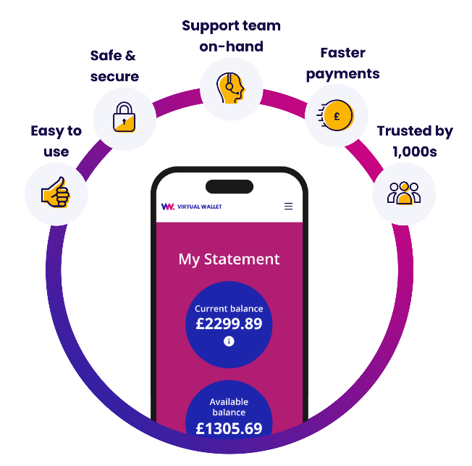
What is Virtual Wallet?
People managing their own care and support via
a direct payment is good as it gives them choice & control.
Virtual Wallet doesn’t change any of that – it just makes it easier for individuals & their families, PAs & providers…and the LA/ICB.
Virtual Wallet is operated by PPL and is a safe and easy way for people to manage a direct payment, all in one place.
The direct payment gets paid straight in to the individuals’ Virtual Wallet accounts. Once the care or support received is confirmed, Virtual Wallet pays the PAs & providers.

Slide 5


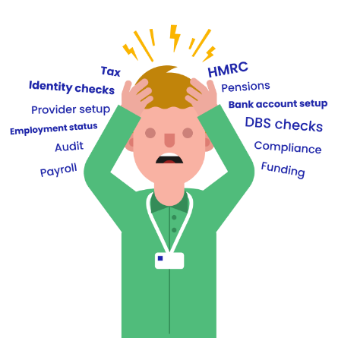

Making it easier for you
Are direct payments giving you a headache?
Let the Virtual Wallet team take the strain
Complete the initial online referral form (which should only take a few minutes), and PPL’s super-friendly onboarding coordinator will take over:
Calling the individual within two days to introduce themselves.
Explaining how Virtual Wallet works, their options and the next steps.
Being on-hand to help the individual and their PAs & providers throughout the entire setup process.
PPL’s target is to process referrals to go-live within 14 days

Slide 6

Intro video

Slide 7
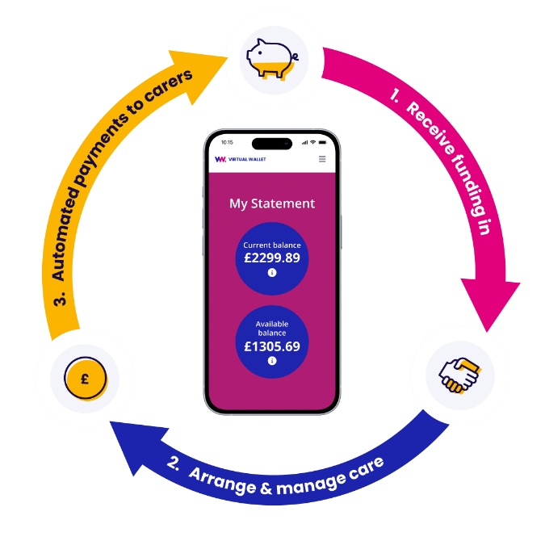
What it means locally
Virtual Wallet [is new for us, has been operating here since mm/yy].
Virtual Wallet is our preferred way of managing direct payments as it makes it easier for individuals, their providers and us.
Over time, it will replace [pre-paid cards, separate bank accounts, managed accounts].
Over time, Virtual Wallet payroll will replace [existing payroll provider].
The Direct Payments Support Service provided by XYZ will still continue.
The Virtual Wallet support team will be on-hand to help people through the change.

Slide 8










How it works
>>Money in>>
>>Money out>>
Arrange and manage care & support
Your local council
Payments to care providers
NHS
Wages to PAs
Client contribution
Tax to HMRC
Client top-up
Pensions contributions
Other sources
Unused funds returned to source
To view all our icons see our asset library
View asset library

Slide 9

How to access
There are three ways an account can be managed:
SELF-SERVICE
Virtual Wallet is designed to be used by the individual receiving the care, using their phone or a computer. PPL call this a self-service account. It can sound daunting, but there are thousands of people using it up and down the UK.
FAMILY & FRIENDS
Self-service isn’t the right choice for everyone. Individuals can ask family or friends to help. PPL call this being an ‘authorised representative’.
SUPPORTED ACCOUNT
Some people may be able to opt for a Supported Account where the team at PPL operate the individual’s Virtual Wallet account for them. These are sometimes also known as a ‘managed account’.
There are one-minute videos that explain each of these at www.myvirtualwallet.co.uk

Slide 10
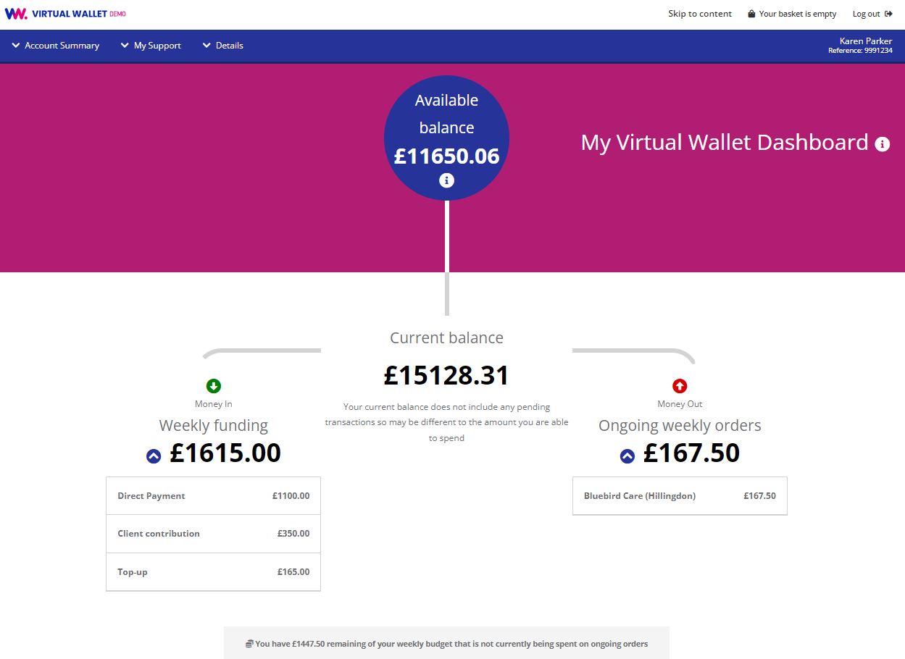
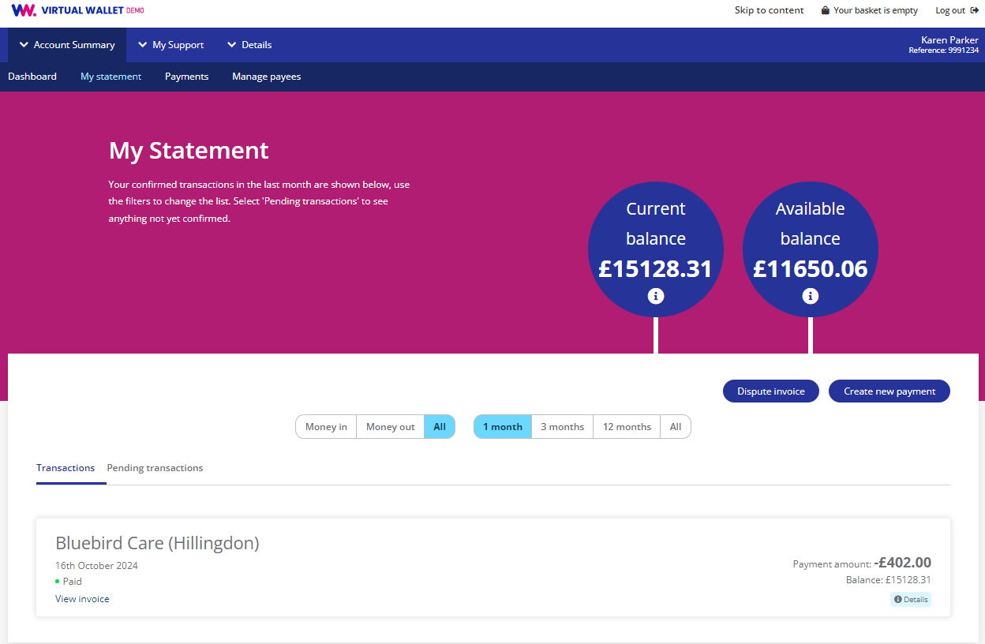
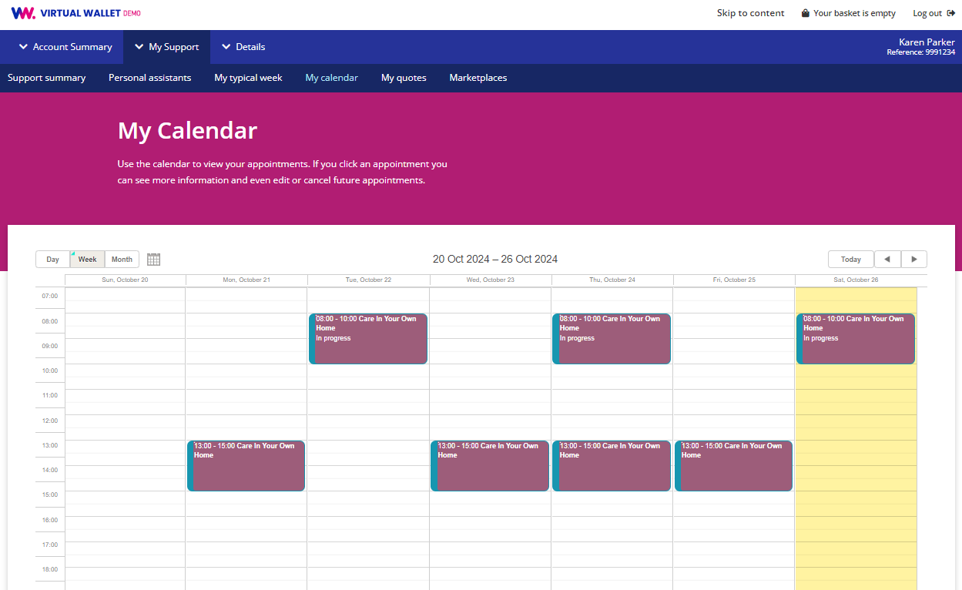
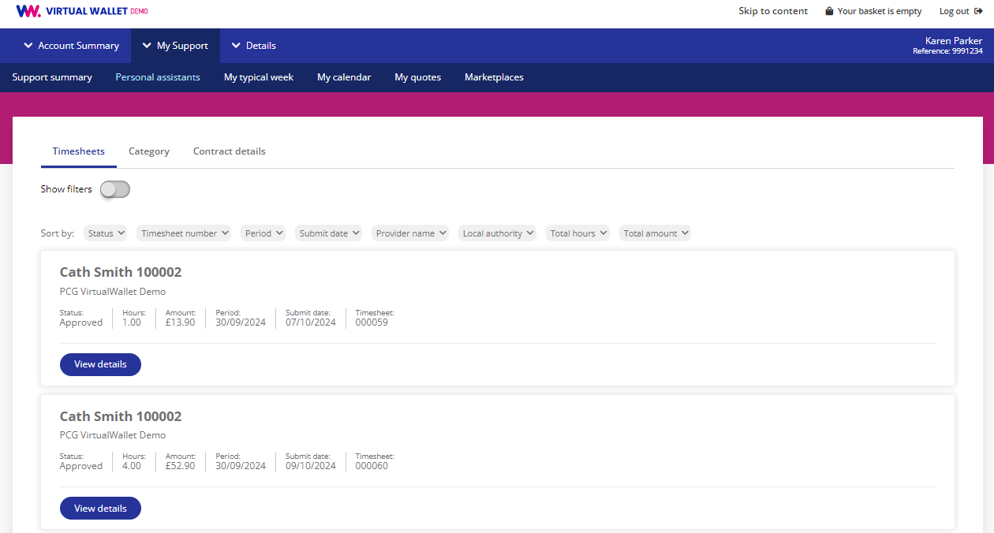
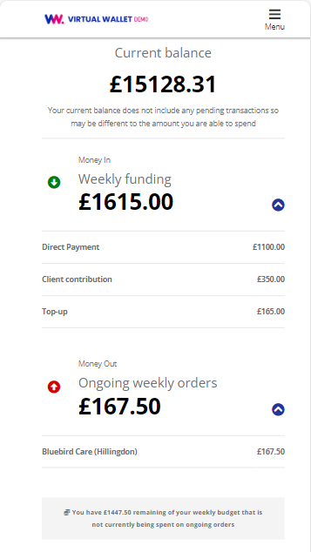
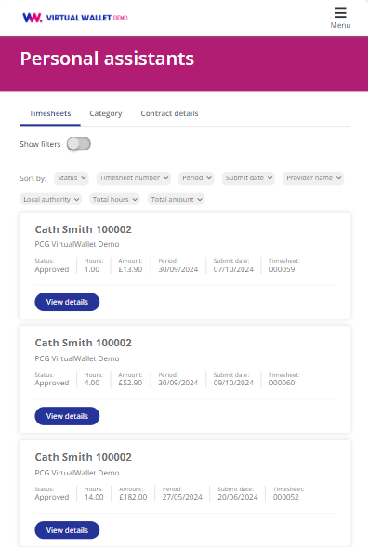
What does it look like?

Slide 11
Where it fits
Step 1 is our existing process. PPL’s target is process referrals (step 2) to go-live (step 4) within 14 days
1
2
3
4
Preparation
VW Referral
VW Setup
VW Go-live
Follow existing process:
Assessment
Discuss a DP
Agree budget
Agree support plan
Internal sign-off
Refer to DP Support Service (if applicable) for advice
By [social worker / XYZ team], via VW Online Enrolment
‘Welcome to VW’ email triggered to individual
PPL liaise with the individual and providers
Individual e-signs our agreement in VW
Finance team send funding to PPL bank account
(Individual sends client contribution to PPL bank account)
Funds credited to individual’s VW account
PA/provider setup completed by PPL
PPL help individual (or auth rep) setup VW account
First orders placed
Review after X weeks
Audit after 6/12 months

Slide 12
The benefits for INDIVIDUALS
Easy, secure, 24/7
Less admin & hassle
VW Support Team are on-hand to help
via web chat, email or phone

Slide 13
The benefits for the LA/ICB
KEY FEATURES
BENEFITS
Developed specially for direct payments
Helpdesk with support for individuals, provider and professionals
Online onboarding process
“Work as” functionality for authorised representatives and professionals
Supported Accounts option
Integrated in-house payroll team option
PowerBI dashboard and reporting
Achieves our aim of more people with choice & control
Expert support is on hand whenever needed
New referral to go-live target <14 days
Staff can view an individual’s account at any time
Lower risk of mis-use or over-spend
PAs & providers will be paid on time
Less time on audit (minutes instead of hours & weeks)
Visibility of unspent funds, easier clawbacks & more funds recycled
Notes:
‘Work as’ function allows other people (an authorised representative or a social worker) to log in to the account of the person receiving care.

Slide 14
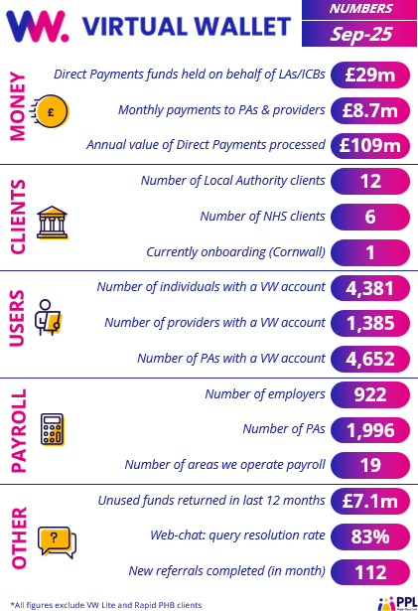

















Virtual Wallet elsewhere

Slide 15

1. Direct payments aren’t new - the only thing changing is how people manage them
2. Virtual Wallet takes the best parts of direct payments and makes them easier
5 things to remember about Virtual Wallet
3. The website myvirtualwallet.co.uk
is a great starting point for you and individuals to find out more
4. The whole point of Virtual Wallet is to make things better for you, the council, the individual and their
PAs & providers
5. Help is on hand
for you from the Virtual Wallet Support Team – via webchat, email and phone
Notes:
1 – Direct payments aren’t new – the only thing changing is how people manage them. Direct payments are given by the council to individuals in need of support so they can arrange and pay for their own care, rather than having social care services directly provided for them. They’ve been around in [area] for many years, and resulted in great outcomes in many cases. None of that is changing – the only difference is that we want individuals to use Virtual Wallet to mange their direct payment.
2. irtual Wallet takes the best parts of direct payments and makes them even better. Direct payments are all about choice and control, and individuals can still do all the things that they previously could with a direct payment – employ their own PA, choose an agency or engage with a micro-enterprise. Virtual Wallet is just a simple way of managing all this, and eliminates a lot of the cost and hassle.
3. The website www.myvirtualwallet.co.uk is a great starting point for you and individuals to find out more. It includes a short videos, FAQs and other resources. Most of the site is aimed at individuals, but there are also specific pages for PAs/Providers and LA/ICB staff.
4. The whole point of Virtual Wallet is to make things better for you, the council, the individual and their providers. Once the initial referral has been made, there should be nothing for care management staff to do! Virtual Wallet meets all the council’s audit trail needs and it helps ensure that providers and PAs get paid the right amount, on time, with no queries.
5. Help is on hand for you from the Virtual Wallet Support Team – via phone, email and webchat. The team at PPL (who operate Virtual Wallet) are friendly and are here to help with any questions you have.

Slide 16
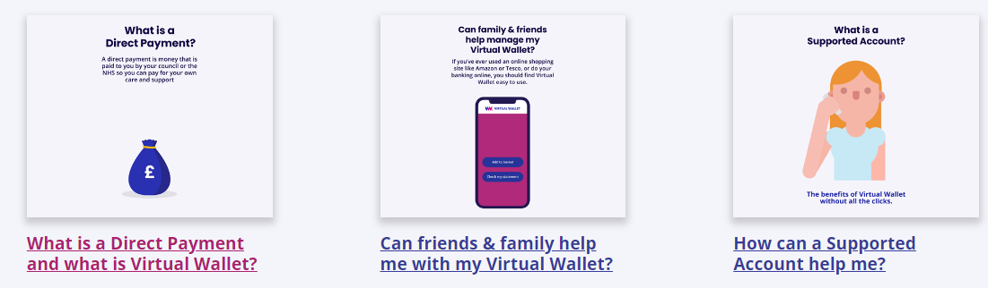
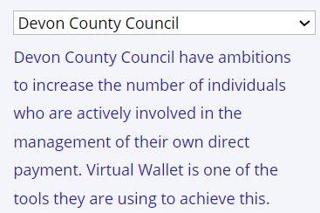
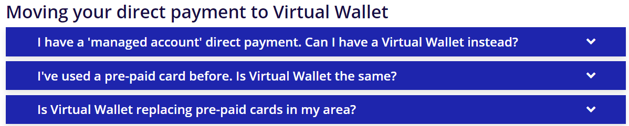

Resources for Individuals
Go to myvirtualwallet.co.uk
One-minute-long explainer videos:
Local info:
Frequently asked questions:
And, once they get started:
How to guides, videos, FAQs, contacts

Slide 17
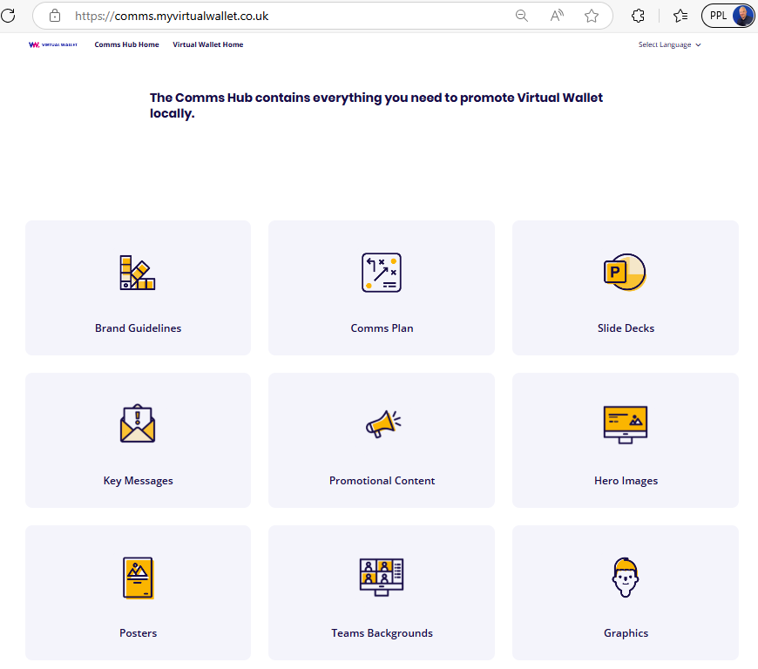
Resources for us
Go to COMMS HUB
You can view and download:
Slide decks
Comms plans
Logos and images
Draft letters
Content for our website
Staff scripts
Posters
Merch
YouTube videos

Slide 19
SUPPLEMENTARY SLIDES
Depending on your audience, you may wish to also include these additional slides
If there is something specific that you want to show that is not covered here, get in touch with your Account Manager at PPL:
Chris Hirst –cchirst@peopleplaceslives.co.uk
Zabi Dashwood – zdashwood@peopleplaceslives.co.uk

Slide 20

How payroll works
When people have a Virtual Wallet account, there are two options for managing payroll if they employ a PA
Option 1. Virtual Wallet Payroll
Option 2. Third-party Payroll
Fully integrated
Timesheet processing and payroll calculations are all done by Virtual Wallet
Everything is in one place
Less risk of delays
Low cost [include comparison]
All queries to the Virtual Wallet team at PPL
Payroll Plus option includes payroll, insurance, training resources & employee assistance program – all within a simple monthly fee
Third-party receives timesheets and do the calculations
They send the information to the Virtual Wallet team for payments to be made from your Virtual Wallet account
Payroll queries to the payroll provider, payment queries to the Virtual Wallet team at PPL
Useful if people especially want to stay with their existing payroll provider
PPL work with several leading third-party providers

Slide 21
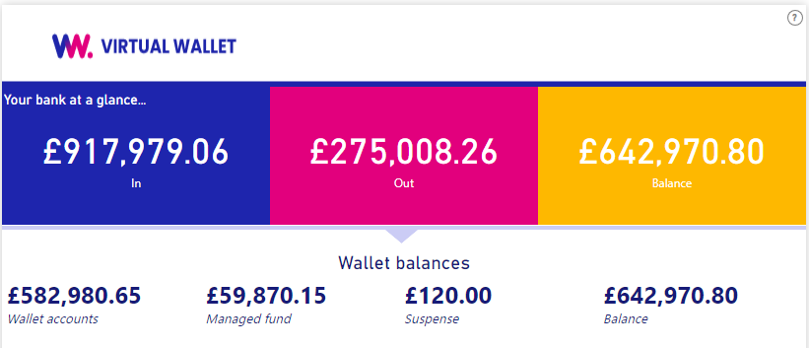
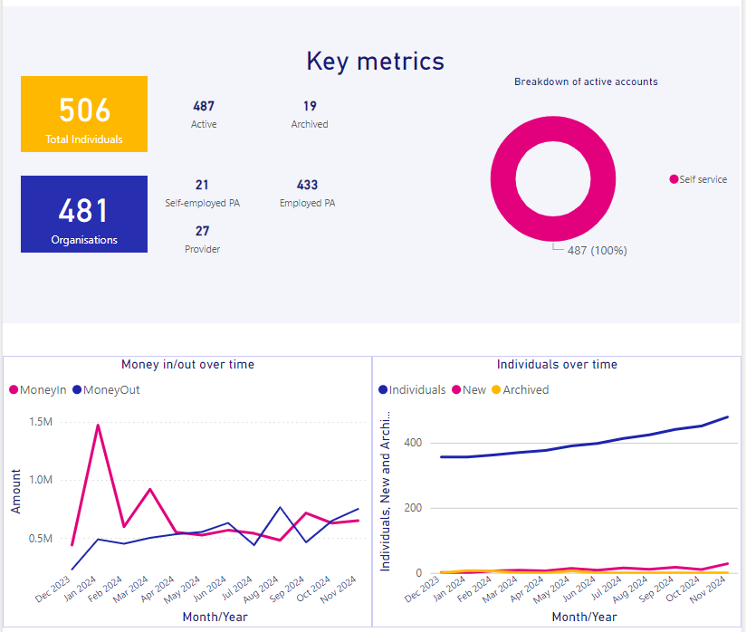
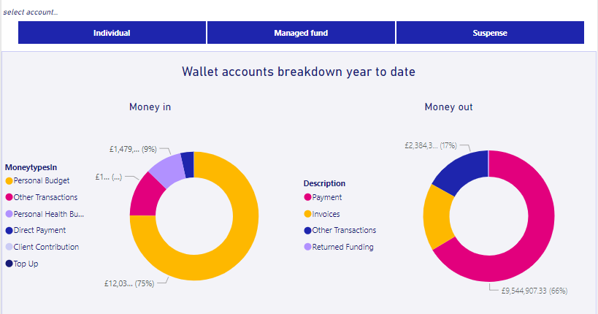
Reporting

Slide 22
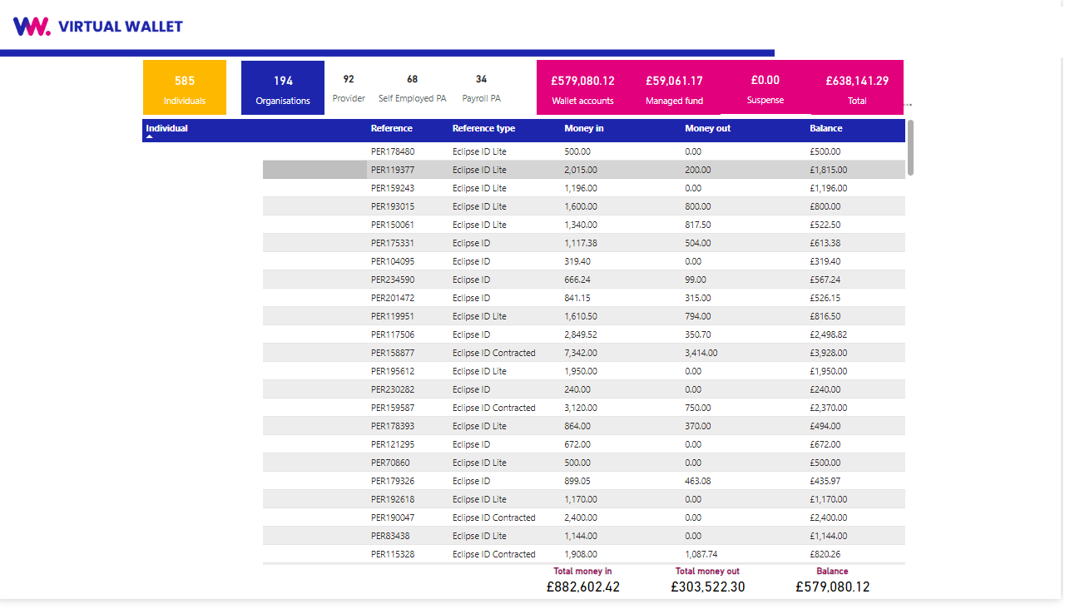
Reporting

Slide 23
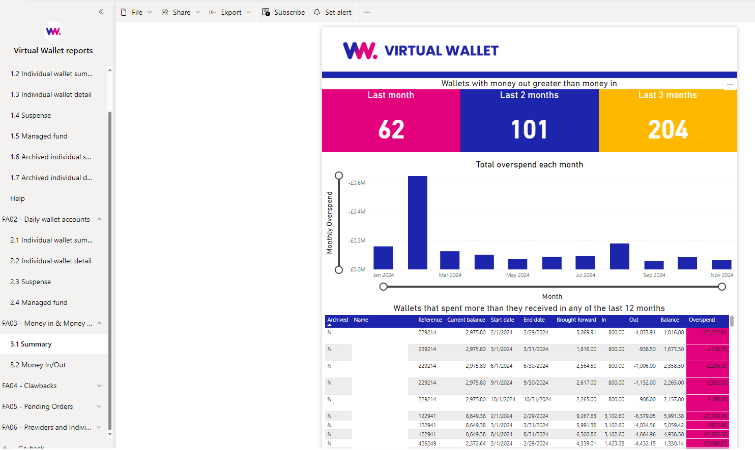
Reporting

Slide 24
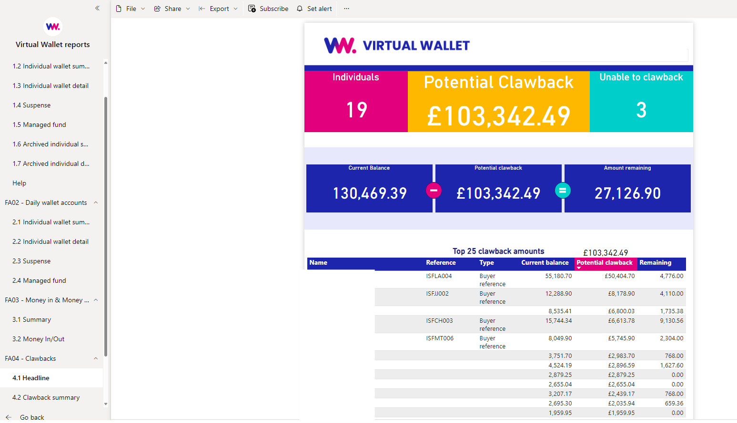
Reporting

