Slide 1
READ ME FIRST
This is a template slide deck to use when presenting Virtual Wallet to PAs and PROVIDERS.
There are separate template slide decks to use when presenting to individuals and LA/ICB staff. Go to: myvirtualwallet.co.uk > Support Hub > Professionals > Comms Hub.
You can amend it to personalise it your local area & audience – for example:
Amend the What it means locally slide and include your logo.
If you are only speaking to PAs, skip slide 11.
If time is short, skip some of the ‘nice to have’ slides (e.g. just use slides 4, 6, 12, 13 & 15)
This template gets updated periodically to incorporate feedback and new developments, so check the Comms Hub regularly, which also includes more images and content that you can download and use in slide decks and elsewhere.

Slide 2
Introduction for PAs
& Providers
October 2025

Slide 3
Contents
What is Virtual Wallet
What it means locally
How it works
What it looks like
The process – set-up to go-live
Benefits
Resources
Summary

Slide 4
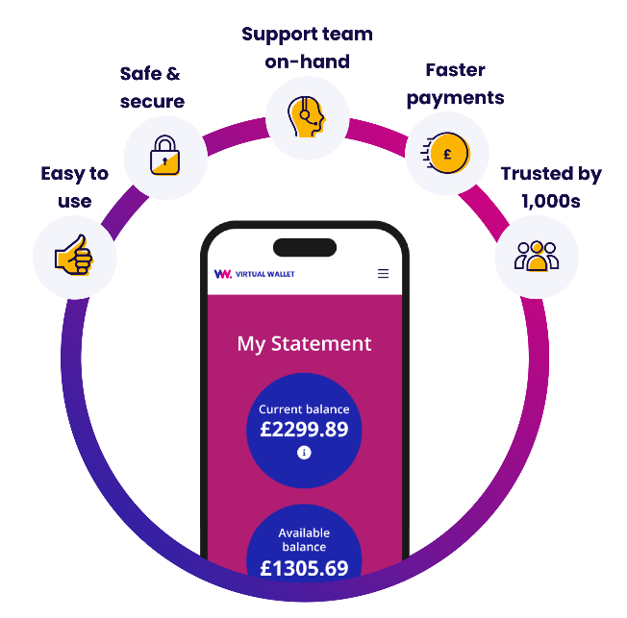
What is Virtual Wallet?
People managing their own care and support via
a direct payment is good as it gives them choice & control.
Virtual Wallet doesn’t change any of that – it just makes it easier for individuals & their families, the funding authorities…and PAs & providers.
Virtual Wallet is operated by PPL and is a safe and easy way for people to manage a direct payment, all in one place.
The direct payment gets paid straight in to the individuals’ Virtual Wallet accounts. Once the care or support received is confirmed, Virtual Wallet pays the PAs & providers.

Slide 5

Intro video

Slide 6
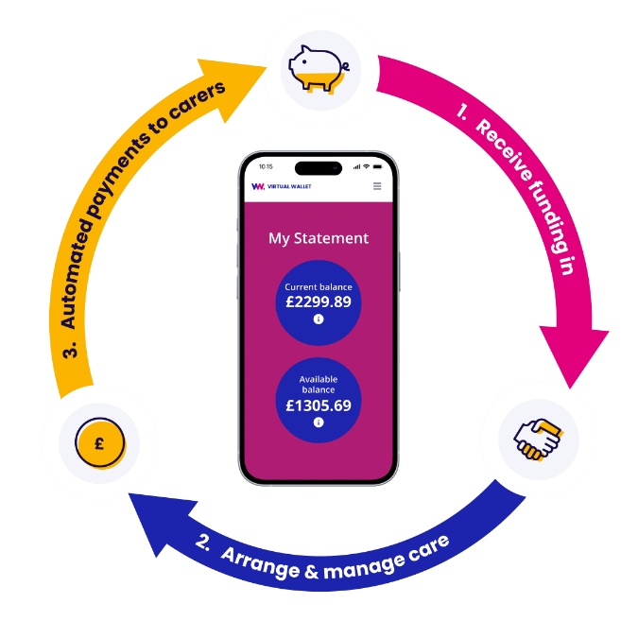
What it means locally
Virtual Wallet [is new for us, has been operating here since mm/yy].
Virtual Wallet is our preferred way of managing direct payments as it makes it easier for individuals, their providers and us.
Over time, it will replace [pre-paid cards, separate bank accounts, managed accounts].
Over time, Virtual Wallet payroll will replace [existing payroll provider].
The Direct Payments Support Service provided by XYZ will still continue.
The Virtual Wallet support team will be on-hand to help people through the change.

Slide 7










How it works
>>Money in>>
>>Money out>>
Arrange and manage care & support
Your local council
Payments to care providers
NHS
Wages to PAs
Client contribution
Tax to HMRC
Client top-up
Pensions contributions
Other sources
Unused funds returned to source
To view all our icons see our asset library
View asset library

Slide 8
How it works
There are four main ways that PAs and providers get paid
EMPLOYED PAs
MICROS / SELF-EMPLOYED PAs
PROVIDERS
AD-HOC /
ONE-OFFS
Two models – VW payroll & third-party payroll
PA submits e-timesheets via VW (or to third-party)
Checked & approved
Payroll calculations completed by VW (or third-party)
Payslip sent to PA
Payments made by VW to PA, HMRC & pension provider within 5 days
Submit timesheets
Checked & approved
VW converts these to an invoice
Invoices paid by VW within 5 days
Micro-provider / self-employed PA is responsible for their own tax
‘Schedule’ created at outset by VW team
Individual ‘orders’ are auto-generated every 4 weeks
Provider confirms order
Service is delivered
Provider confirms delivery (quantity)
VW auto-generates an invoice for approval
Invoices paid by VW within 5 days
Provider generates their own invoice and sends it to the individual
Individual checks it manually and uploads it to VW
Manually checked & approved
If there are sufficient funds, VW pays the invoice on the next payment run

Slide 9

How payroll works
When people have a Virtual Wallet account, there are two options for managing payroll if they employ a PA
Option 1. Virtual Wallet Payroll
Option 2. Third-party Payroll
Fully integrated
Timesheet processing and payroll calculations are all done by Virtual Wallet
Everything is in one place
Less risk of delays
Low cost
All queries to the Virtual Wallet team at PPL
Payroll Plus option includes payroll, insurance, training resources & employee assistance program – all within a simple monthly fee
Third-party receives timesheets and do the calculations
They send the information to the Virtual Wallet team for payments to be made from your Virtual Wallet account
Payroll queries to the payroll provider, payment queries to the Virtual Wallet team at PPL
Useful if people especially want to stay with their existing payroll provider
PPL work with several leading third-party providers

Slide 10
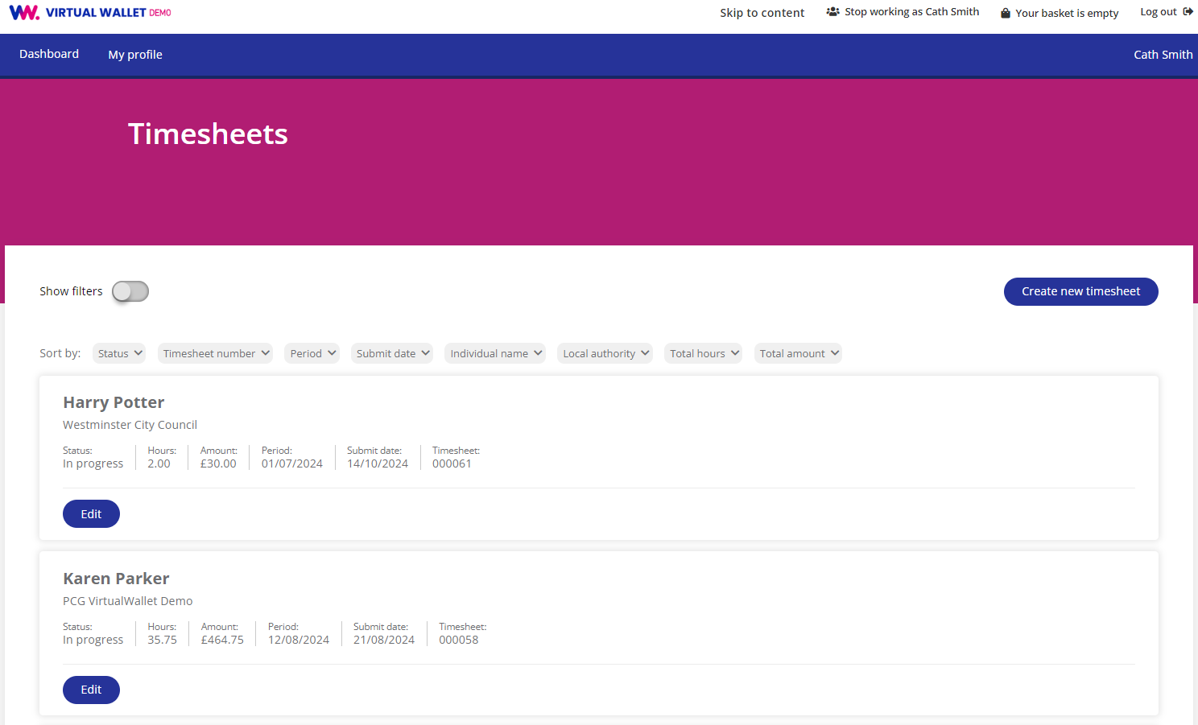
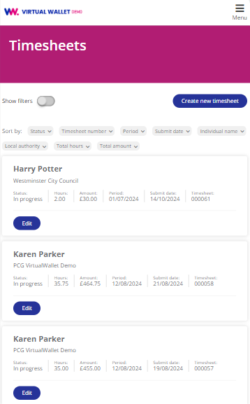
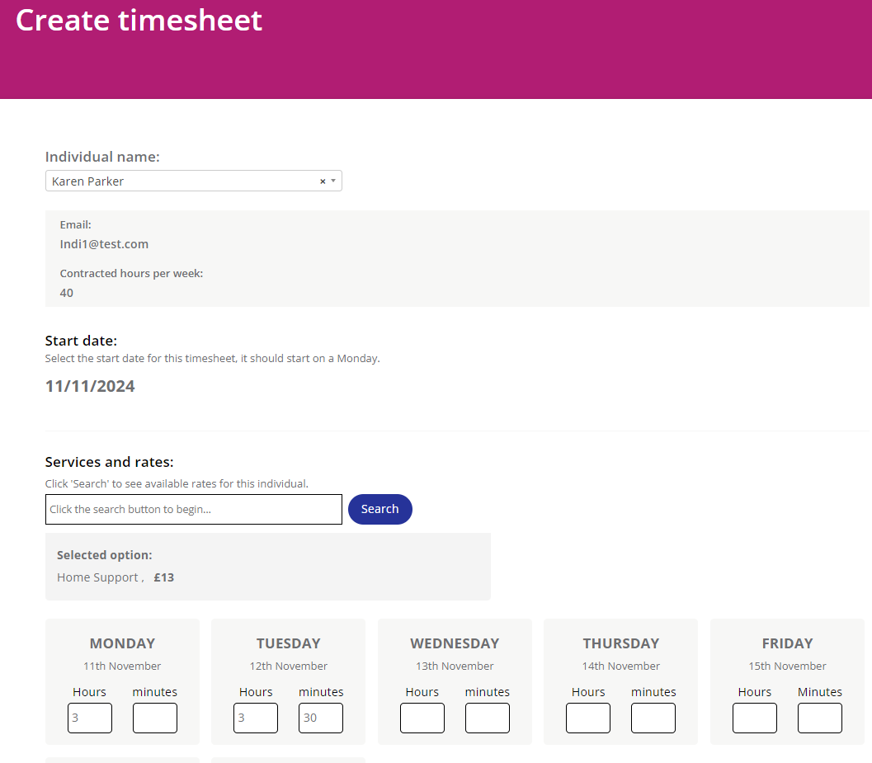
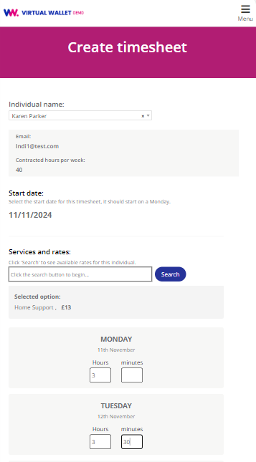
What does it look like - PAs

Slide 11
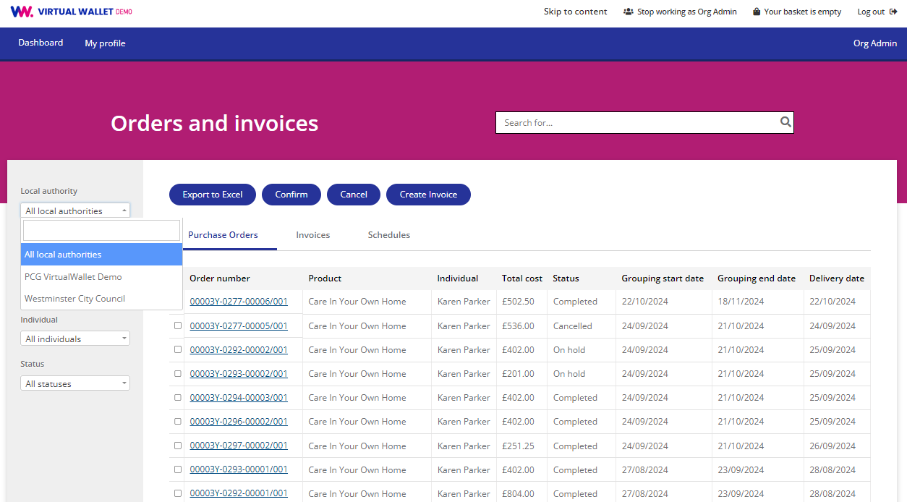
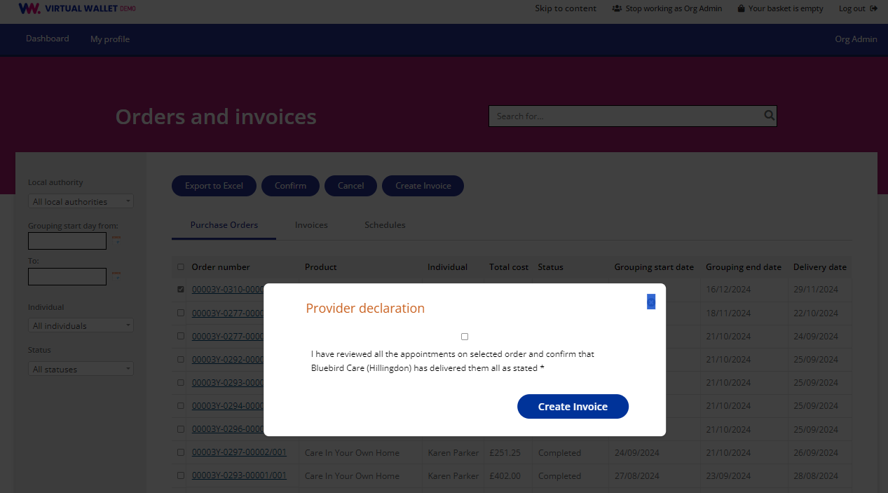
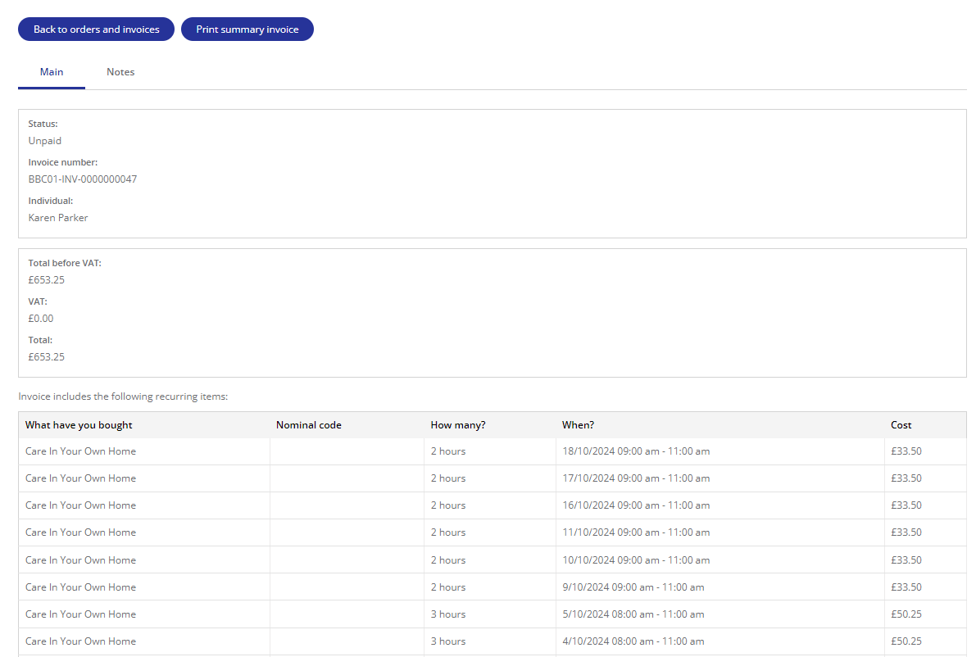
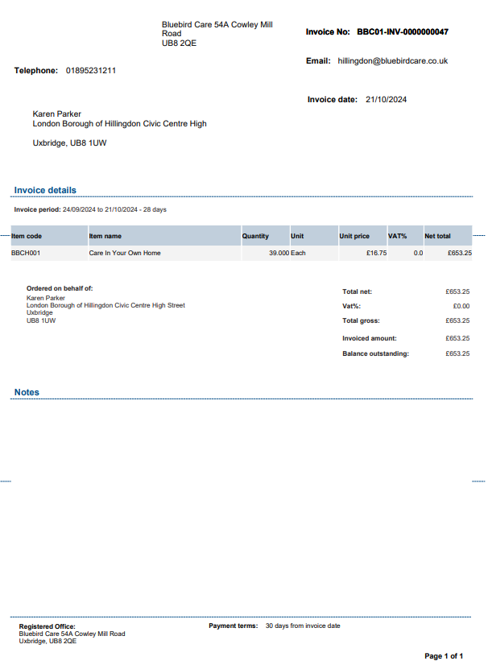
What does it look like - Providers

Slide 12
PA and provider process
Virtual Wallet is an integral part of the process
1
2
3
4
Onboarding
Setup
Schedules
Operations
Initiated by the individual
‘Welcome to VW’ email with link to activate account
Complete online setup forms (what you provide, bank details etc)
VW team populate your account & configure access
In parallel, VW team are setting up the individual’s account
VW team create schedules of support
Triggered when individual ‘goes live’ (when their first funding payment is received)
Providers confirms orders and confirm delivery
PAs submit timesheets
Payments made (within 5 days)

Slide 13
The benefits for PAs and providers
KEY FEATURES
BENEFITS
Developed specially for direct payments
Online onboarding process for PAs and providers
System incorporates best practice around commitment accounting and audit trails
Integrated payroll option where PAs are employed
Helpdesk with support for individuals, professionals, providers and PAs
Costs are funded by LA/ICB
Zero cost to PAs & providers
Eliminates all the paperwork and emails
Standardised process for dealing with every direct payment holder
Swift payment (5 days)
Reduces payment queries and bad debt risk
Expert support is on hand whenever needed
Visibility for PAs & providers 24/7
Notes:
‘Work as’ function allows other people (an authorised representative or a social worker) to log in to the account of the person receiving care.

Slide 14
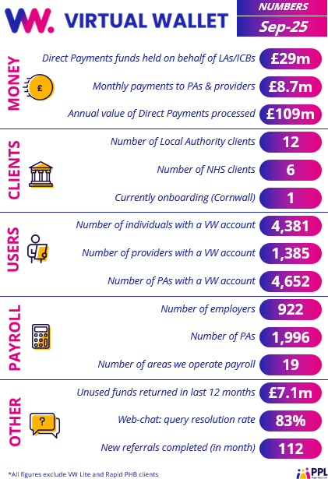

















Virtual Wallet elsewhere

Slide 15
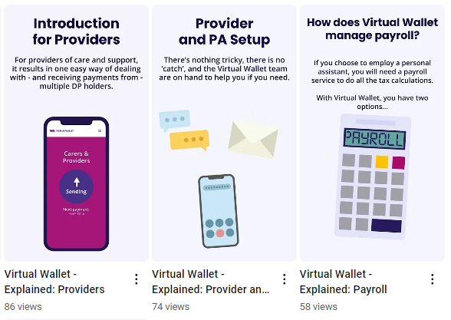
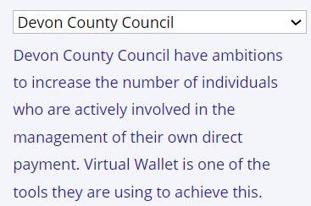
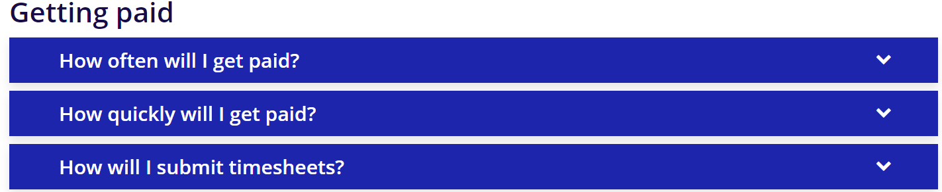

Resources for PAs & providers
Go to myvirtualwallet.co.uk
One-minute explainer videos:
Local info:
Frequently asked questions:
And, once you get started:
How to guides, videos, FAQs, contacts

